Slide 1





Project: Home Irrigation Control System (HICS) Team: SmartGrass
CSE Senior Design I
Architecture Design Specification
CSE 4316 Final Exam
Belachew
Haile-Mariam(L)
Gautam
Adhikari
Jeremiah
O’Connor
Tung
Vo
Notes:
This presentation demonstrates the new capabilities of PowerPoint and it is best viewed in Slide Show. These slides are designed to give you great ideas for the presentations you’ll create in PowerPoint 2010!
For more sample templates, click the File tab, and then on the New tab, click Sample Templates.

Slide 2
Instructions
[Delete this slide from your presentation]
Each team will prepare a 20-minute (maximum) presentation that follows this template
Submit your presentation via email to odell@uta.edu by 8:00 am on Monday, 5/10/2014 (exam date)
Presentations will be made from the slides you submit, no updates after submission
Late submissions is a 20% penalty, no exceptions
Order of presentations will be determined on exam day
Instructor will ask questions based on your presentation and your draft ADS.
Questions will be directed by name covering any part of the presentation that I choose
I.e., everyone on the team should be very familiar with the entire contents of presentation

Slide 3
Guiding Principles
Team Member

Slide 4
Guiding Principles
Scalability
The HICS product must be scalable to give users the freedom to add or remove valves or sensors as they choose within the limits of the system. This affects what hardware expansion elements are built into the system.

Slide 5
Guiding Principles
Ease of Use
The web application interface must be intuitive and user-friendly. This means building the UI interface with simple and easy to understand components like large buttons and descriptive labels. Ease of use also means limiting the number of functions a user must go through to control their system.

Slide 6
Guiding Principles
Maintainability
The HICS system should be designed and implemented in such a way that the system requires minimal maintenance after purchase. All rain, temperature, and soil sensors should be replaceable and reinstallation should be possible at the user level. This will mean that the central control unit will have to be built with a plug and play type hardware interface for all sensors.

Slide 7
Guiding Principles
Compatibility
Since not all sprinkler systems are designed the same, HICS should be designed to not rely on any proprietary equipment to be installed. The means designing the central control unit to connect directly with the valve wires to ensure the majority of existing sprinkler systems are compatible.

Slide 8
Top 3 Guiding Principles
[Principle 3]
[Description of this principle relative to your system’s design]
[Describe how you will ensure that you follow this principle in your design]

Slide 9
Top 3 Guiding Principles
[Principle 2]
[Description of this principle relative to your system’s design]
[Describe how you will ensure that you follow this principle in your design]

Slide 10
Top 3 Guiding Principles
[Principle 1]
[Description of this principle relative to your system’s design]
[Describe how you will ensure that you follow this principle in your design]

Slide 11
Layer Definitions
Team Member

Slide 12
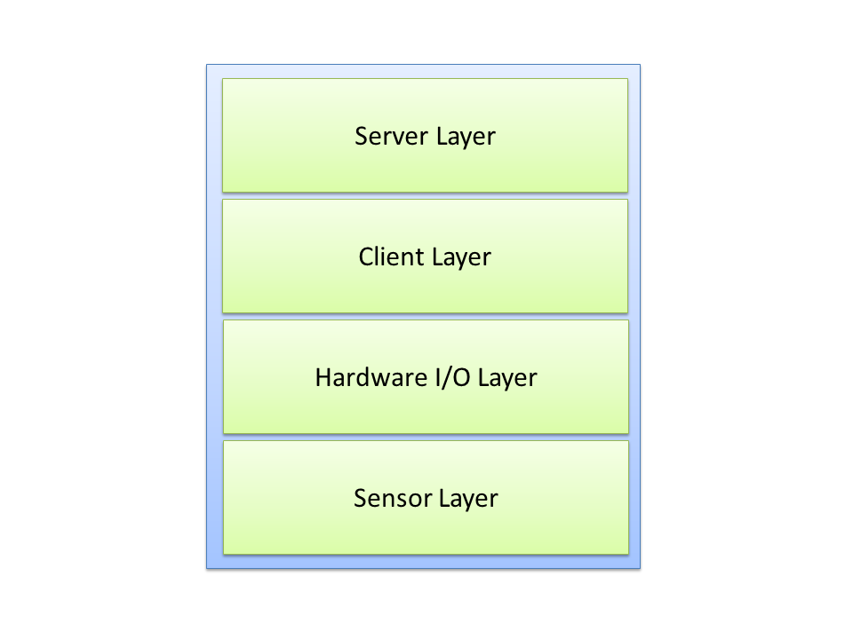
Layer Structure Overview

Slide 13
Sensor Layer
Purpose
Gathering data from the sensors to monitor different environment conditions
Providing service(s):
Sending all the different environment condition readings to the Hardware I/O Layer.
Expecting service(s):
Including 3 kinds of sensor, electronic components, not expecting any service from other layers

Slide 14
Hardware I/O Layer
Purpose
Collecting information from the environment sensors
Controlling the activities of the irrigation valves
Providing service(s):
Taking input data from sensors
Differentiating the input
Formatting the data to be sent to Client layer
Expecting service(s):
Sensor reading as input data from Sensor Layer
Control command data from Data processing at Client Layer

Slide 15
Client Layer
Purpose
Handling the communication between Hardware I/O Layer and Server Layer
Providing service(s):
Taking sensor input from Hardware I/O Layer and sending it to Server Layer.
Receiving response from Server Layer and sending it to Hardware I/O Layer.
Expecting service(s):
Sensor input form Hardware I/O Layer
Data response from Server Layer

Slide 16
Server Layer
Purpose
Handling the interfacing with the users
Processing the requests from Client Layer
Updating information to Database
Providing service(s):
Handling request and sending response to Client Layer.
Expecting service(s):
Requests from Client Layer

Slide 17
Subsystem Definitions
Team Member

Slide 18
Sensor Layer Subsystems
Rain Sensor: Detect precipitation amounts by collecting rainfall to alert the rain condition
Temperature Sensor: Measure the current temperature of the environment
Soil Moisture Sensor: Measure the current soil moisture sensor at its corresponding irrigation zone.

Slide 19
Hardware I/O Layer Subsystems
Sensor Controller:
Interface directly to all sensors, read the signal transmitted from the sensors
Sending the sensor input to Data Processing subsystem
Valve Controller:
Interface directly to irrigation valves
Receive control command from Data Processing subsystem to turn the valves on or off

Slide 20
Client Layer Subsystems
Service Caller:
Taking information from the Data Processing subsystem and sending it to the Web Service at Server Layer
Receiving response form the Web Service and sending it back to Data Processing subsystem
Data Processing:
Parsing sensor data form Sensor Controller, processing, passing this data to Service Caller
Parsing data form Server Caller, formatting it and relaying it to the Valve Controller

Slide 21
Server Layer Subsystems
Web Application: Providing GUI to users, presenting information and accepting input from users
Database: A central hub for data communication between the server and client layers
Web Services: A communication link between the client systems and the database.

Slide 22
Inter-subsystem Data flow
Team Member

Slide 23
Data Flow Descriptions
Data Element ID | Description | Source | Sink
U1 | User enters input into the web application or interacts with the applications GUI. | User/Admin | Web App
A1 | User requested data is presented through the application GUI on the user’s web or mobile browser. | Web App | Web Browser
A2 | Data is received from the user to either update or request information about their system. | Web App | Database
DB1 | Requested data from the web application query is located and returned. | Database | Web App
DB2 | Requested data from the web service query is located and returned. | Database | Web Services
S1 | The data requested from the client is queried or data is sent to the database for storing. | Web Services | Database
S2 | The service caller receives a response from a web service with requested information or a response status code. | Web Services | Service Caller
C1 | A request sent to the web service for either a valve switch command (on/off), data update response, or the caller sends new sensor readings for storage. | Service Caller | Web Services

Slide 24
Data Flow Descriptions (cont’d)
Data Element ID | Description | Source | Sink
C2 | Data returned by the web service is relayed to the data processor to check for valve switch commands to turn the water valves on or off. | Service Caller | Data Processing
P1 | Data from the sensors is processed and formatted then passed to the service caller. | Data Processing | Service Caller
P2 | Response data from the service caller is processed and an operation command is sent to the valve controller. | Data Processing | Valve Controller
SC1 | Parsed data from the sensors is sent to the data processing subsystem. | Sensor Controller | Data Processing
IV1+ | Control signals are parsed and sent to the irrigation valves to turn them on or off. | Valve Controller | Irrigation Valve(s)
RS1 | An alert signal is sent from the rain sensor if a specified amount of rain has been detected. | Rain Sensor | Sensor Controller
TS1 | A temperature reading from the temperature sensor is sent to the sensor controller for parsing. | Temperature Sensor | Sensor Controller
SS1+ | Soil moisture readings are sent from the soil sensors to the sensor controller for parsing. | Soil Sensor(s) | Sensor Controller

Slide 25
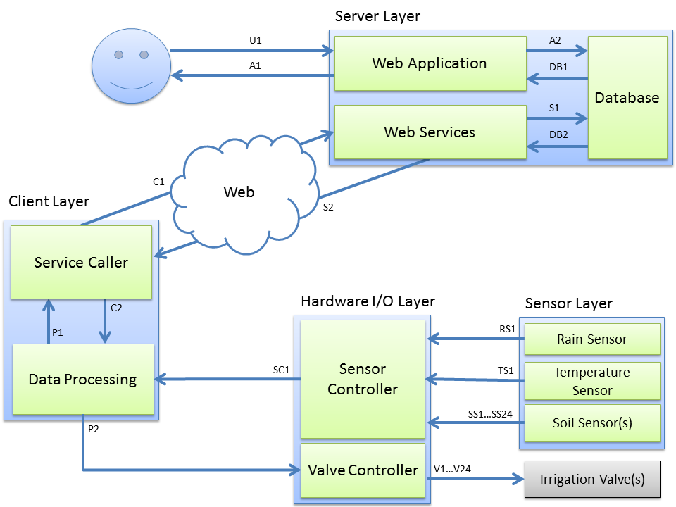
Subsystem Data Flow Diagram

